Slide 1

Debt sustainability during the pandemic
Luuk Oudshoorn

Slide 2
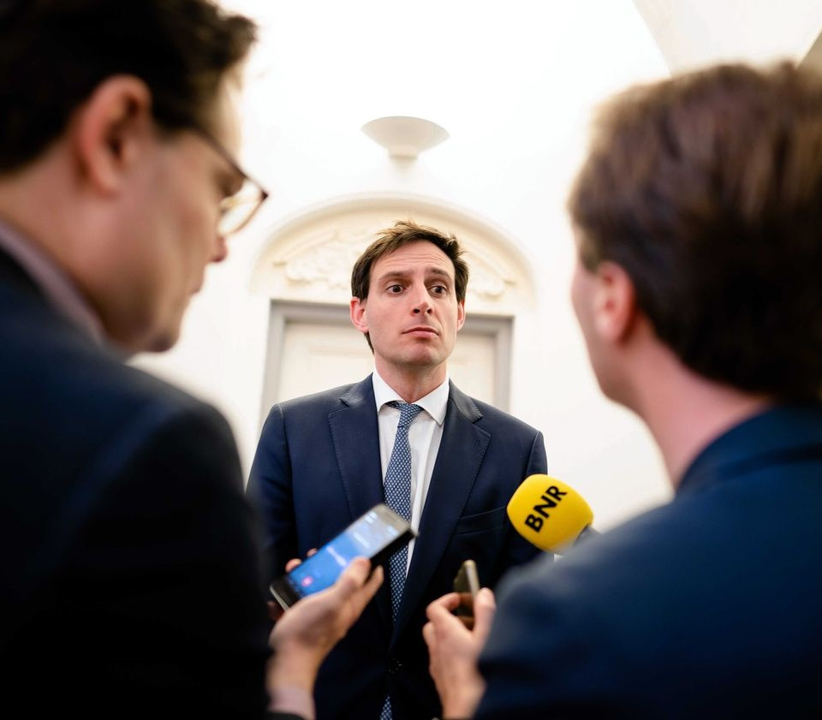
Supporting the economy
In March, the government announced up to 90B financial support.
Costs of COVID so far: 45-144B
1. Kolen (2020) ESB 4791 504-509
2. Frijters (2020) ESB 4791 510-513

Slide 3


Fiscal stimulus
Job retention schemes
Liquidity support
Cash transfers to businesses
Looking ahead: NGEU
FISCAL MONITOR: Policies for the Recovery (IMF, 2020)
The risk of 9 million zombie jobs in Europe (Utermöhl, Ozyurt, and Subran 2020)
Hagen-Zanker J., Bastagli F., Harman L., Barca V., Sturge G., Schmidt T.,2016, ODI Briefing. London: Overseas Development Institute
Brunnermeier M., Krishnamurthy A., 2020
Wilson D. J., 2012, American Economic Journal: Economic Policy, 4, 251

Slide 4
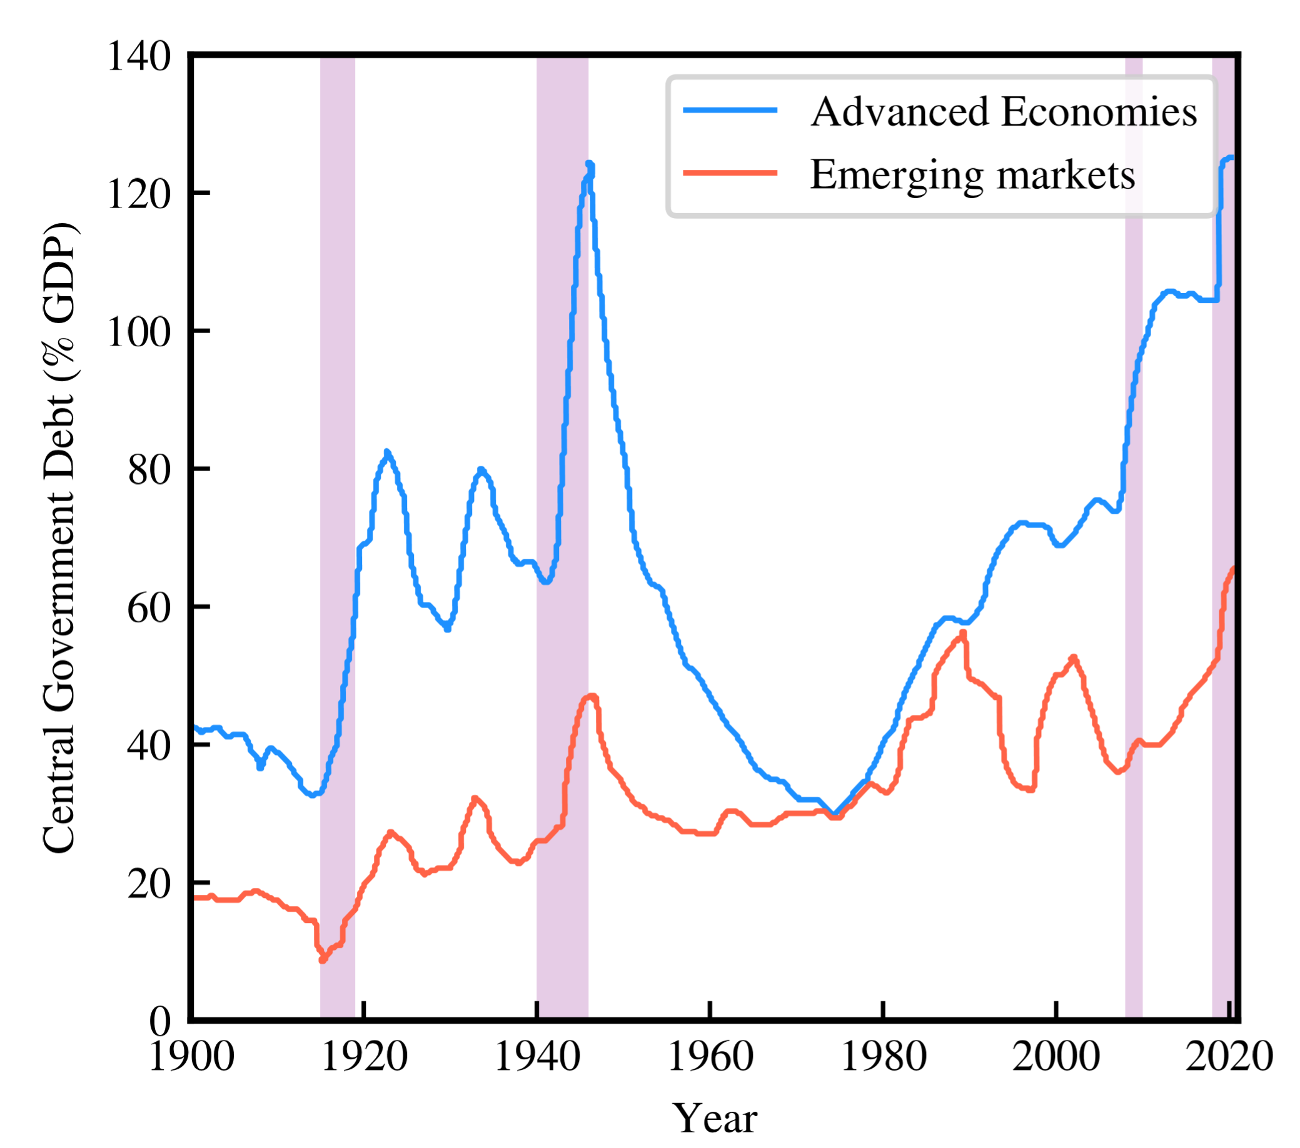
Financing these expenses
Lower taks revenue and higher costs
Government deficit
Debt issuance

Slide 5
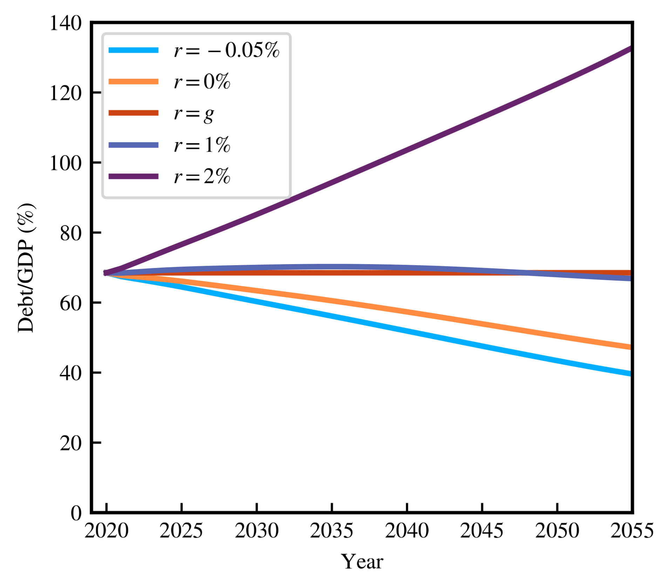
Stability and sustainability
Since 1980s ever increasing debt
Worries about sustainability
Trade-off

Slide 6
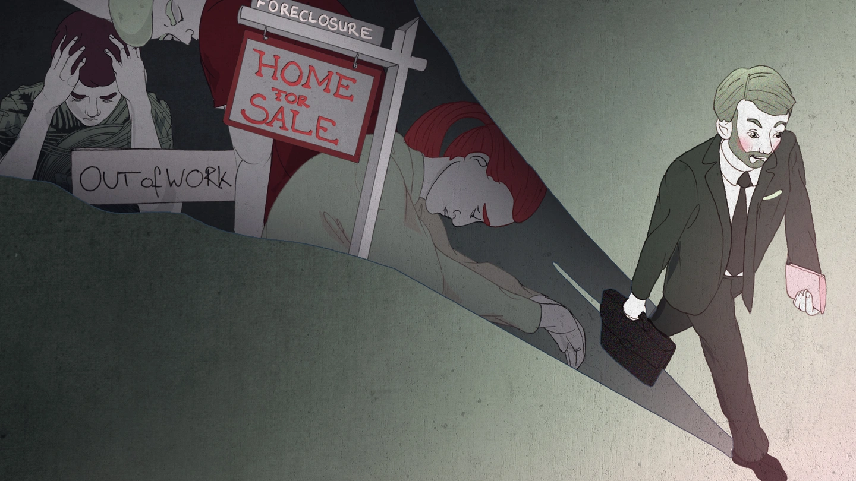
Historical evidence
Can we look at historical fiscal and monetary parameters to create future expectations?

Slide 7
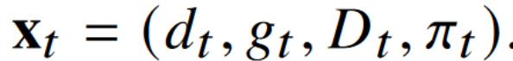
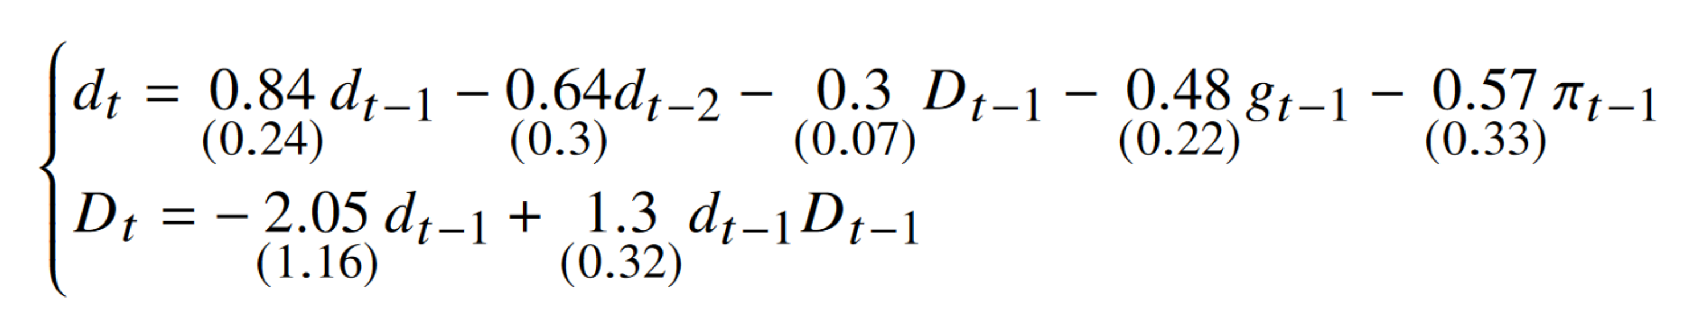
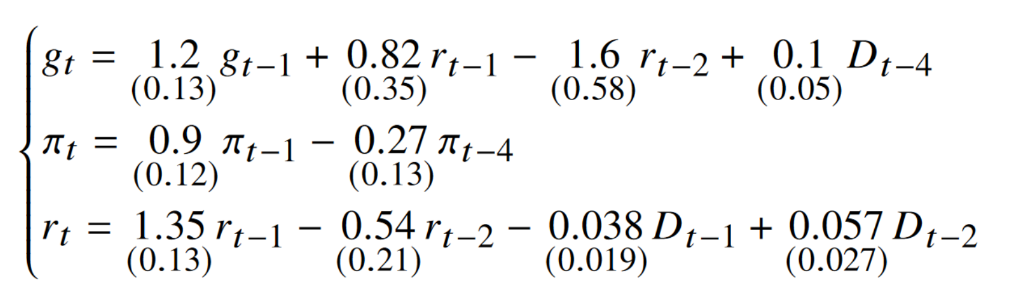
Dynamic behaviour
Government deficits
Debt
GDP growth
Interest rate + inflation
https://data.oecd.org/
https://countryeconomy.com/deficit/netherlands
https://www.imf.org/external/datamapper/GG_DEBT_GDP@GDD/SWE/NLD
https://www.imf.org/external/datamapper/datasets

Slide 8
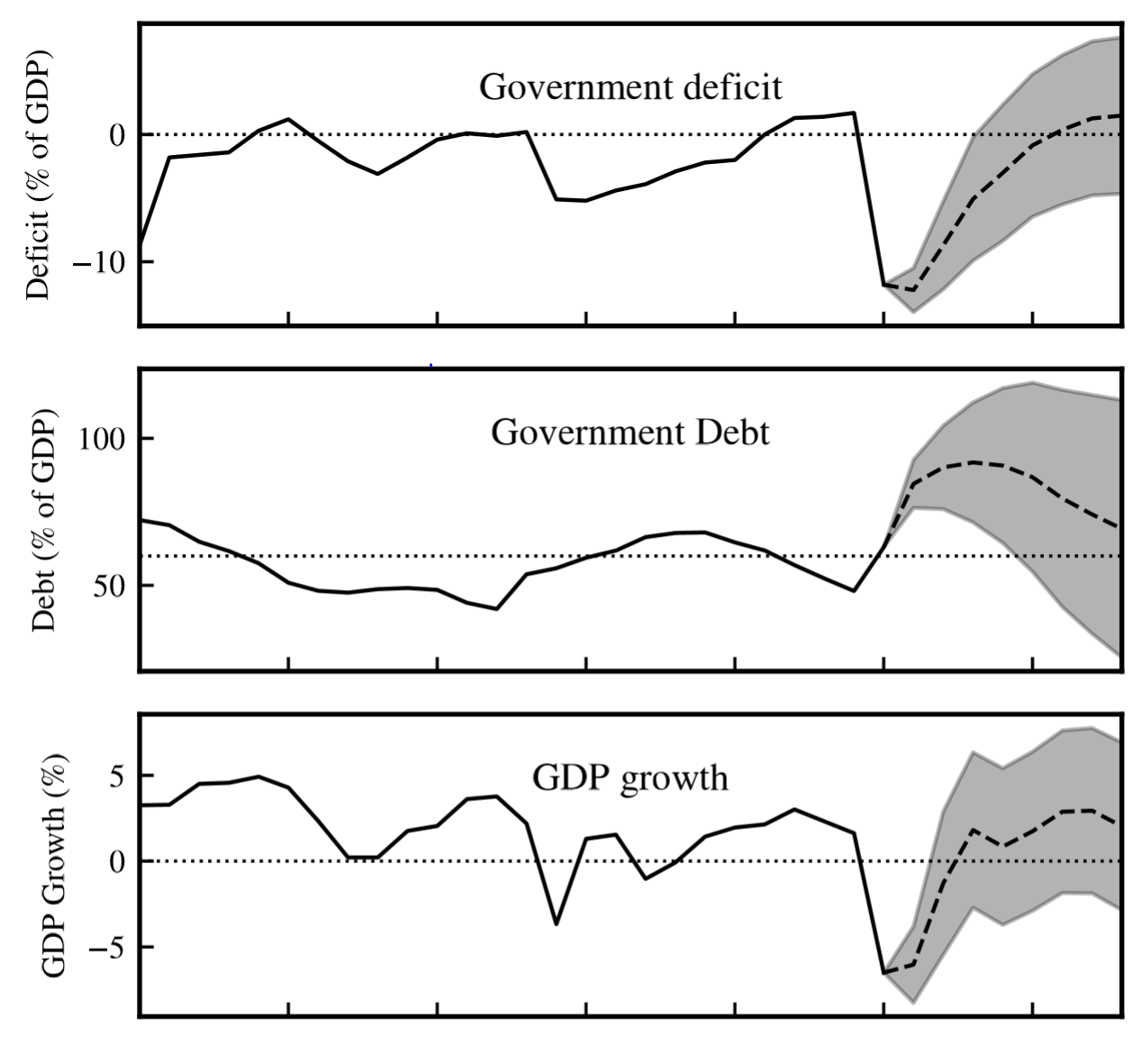
Dynamic behaviour
Government deficits
Debt
GDP growth
Interest rate + inflation
https://data.oecd.org/
https://countryeconomy.com/deficit/netherlands
https://www.imf.org/external/datamapper/GG_DEBT_GDP@GDD/SWE/NLD
https://www.imf.org/external/datamapper/datasets

Slide 9
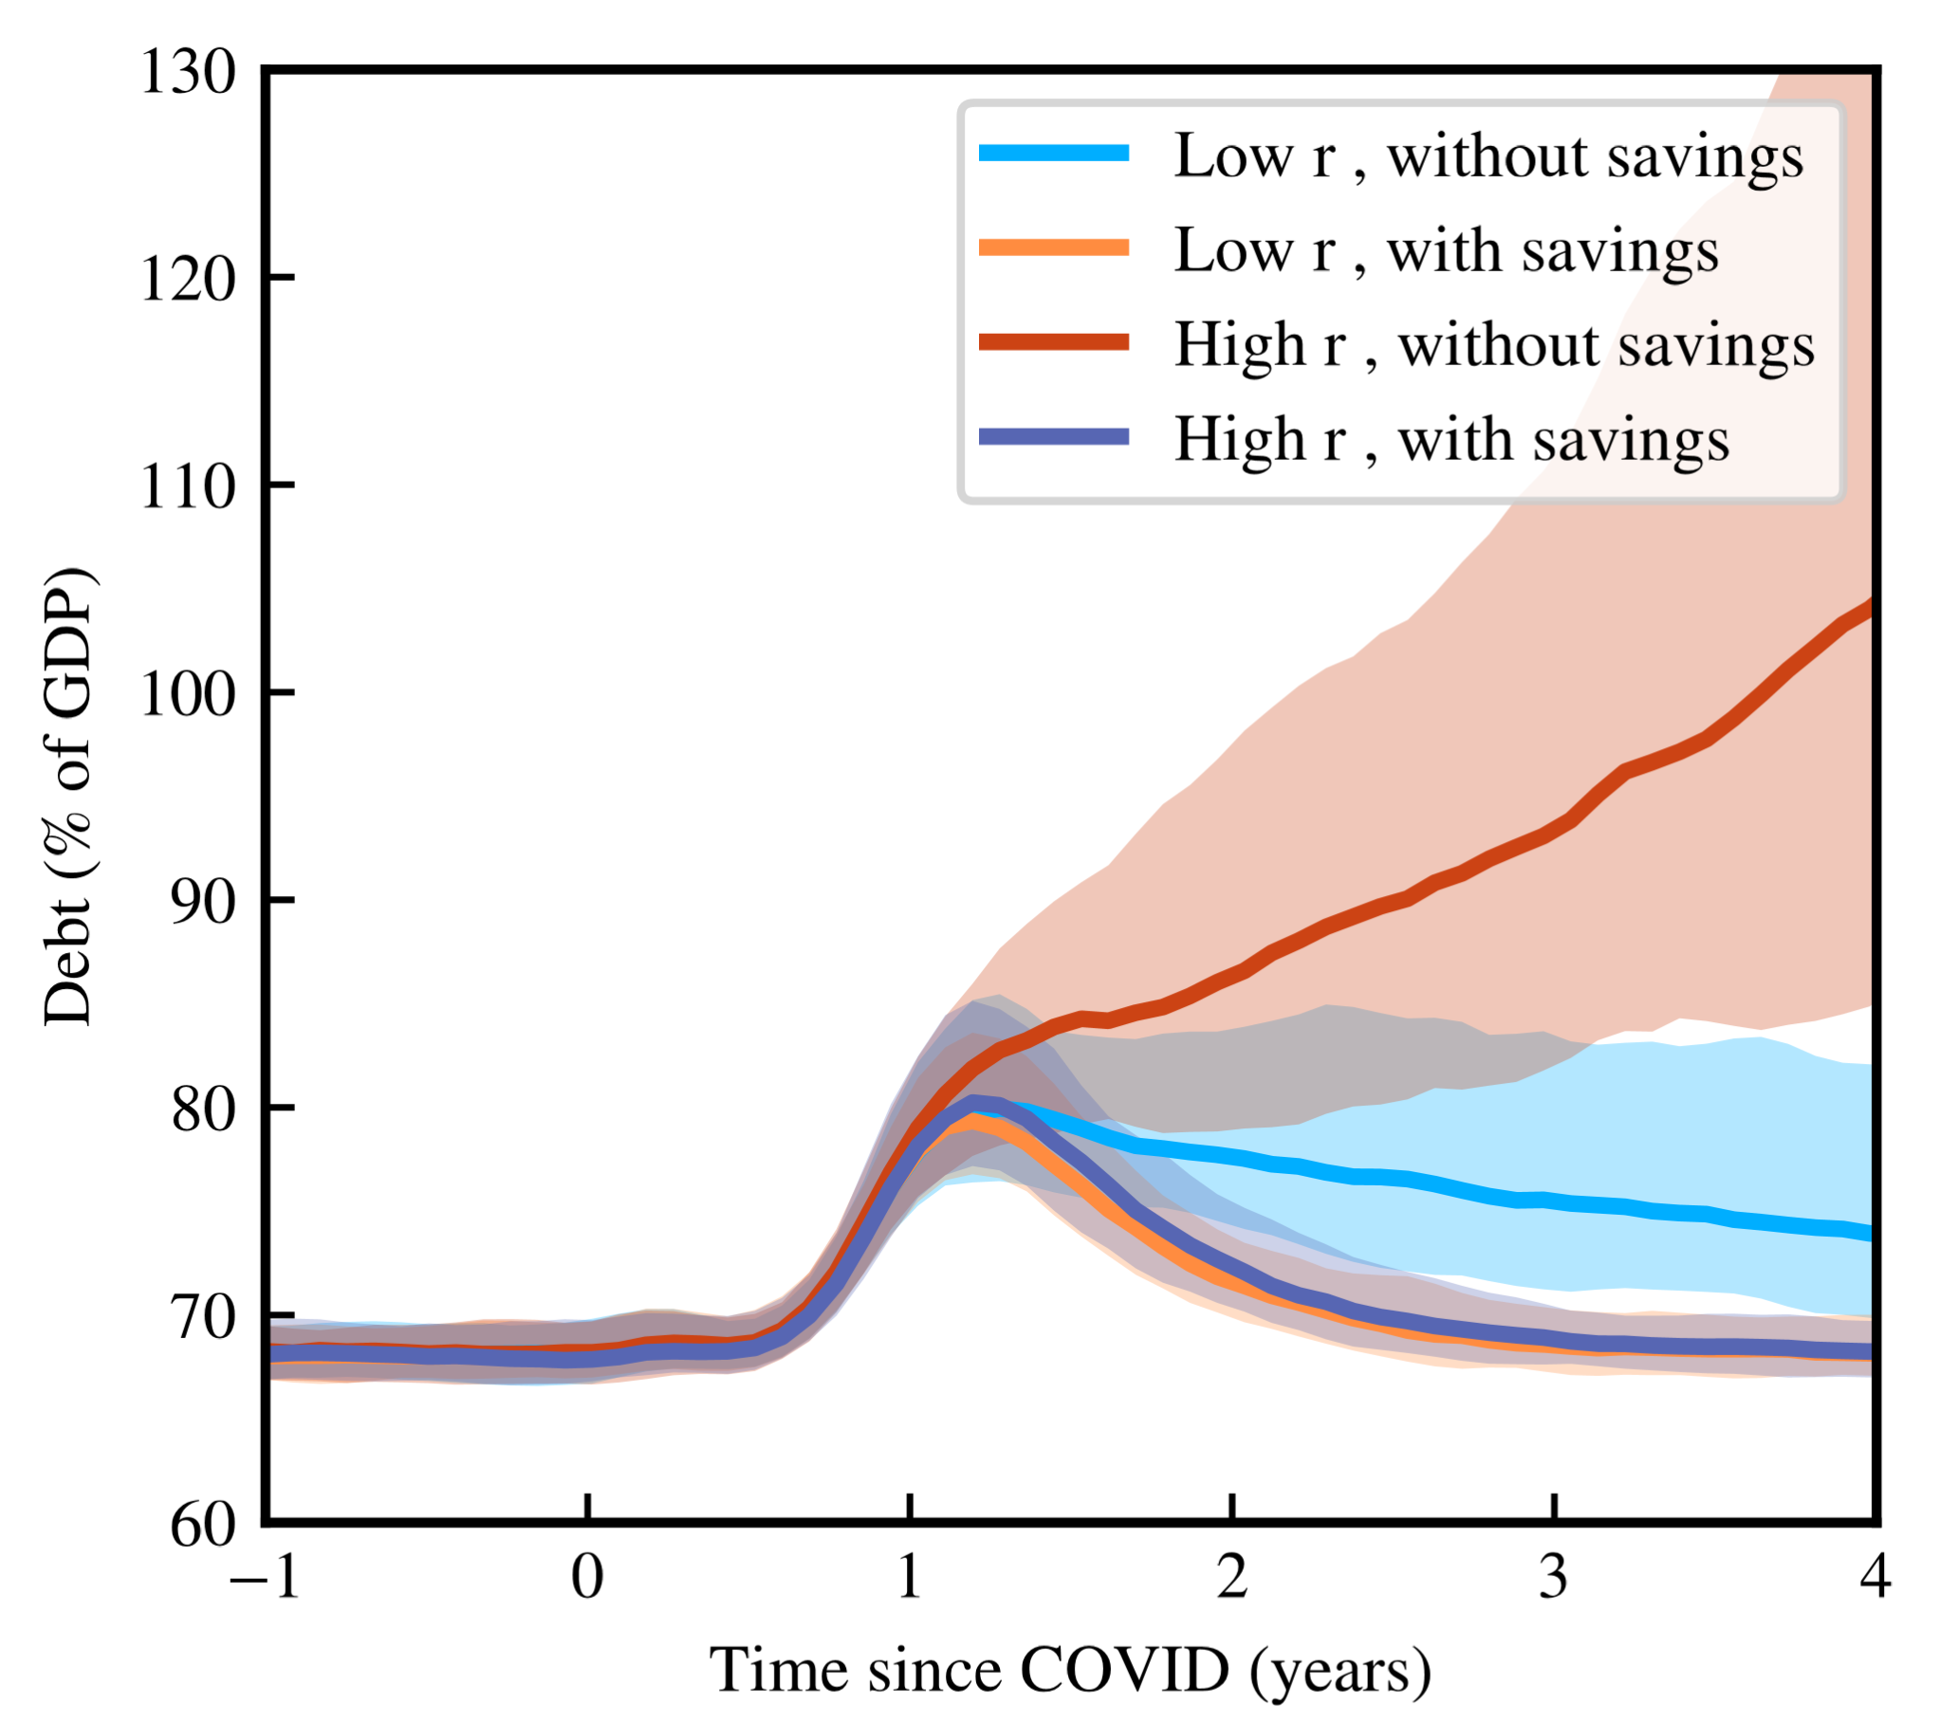
Key factors
Savings
But even more: r-g

Slide 10
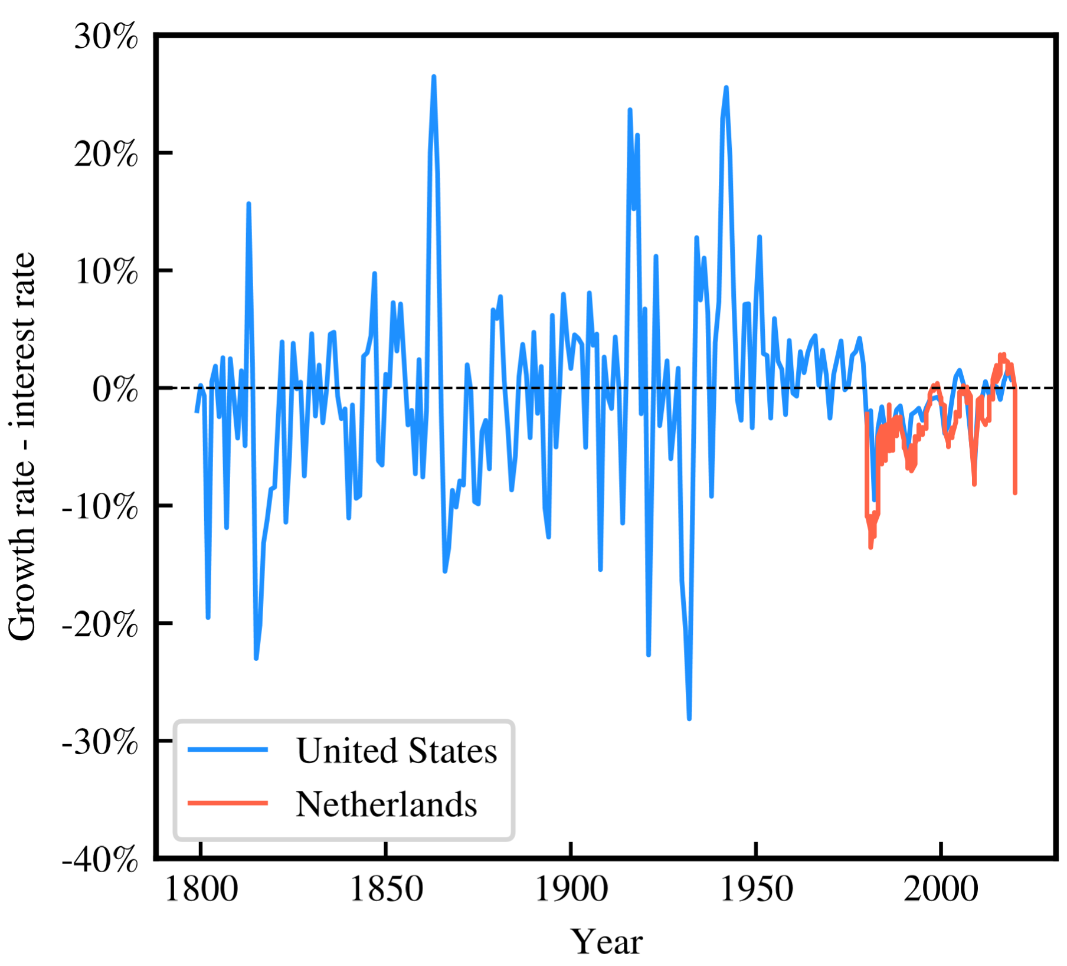
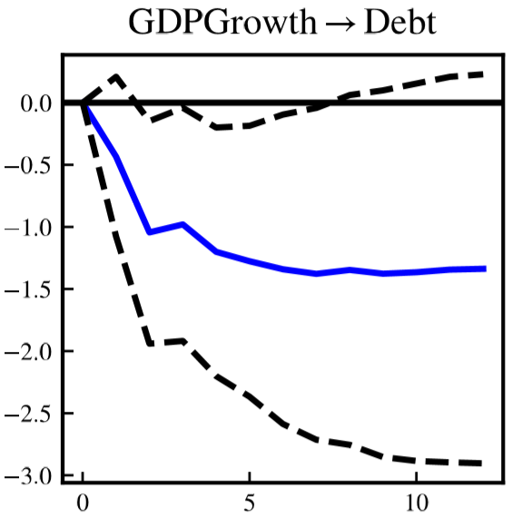
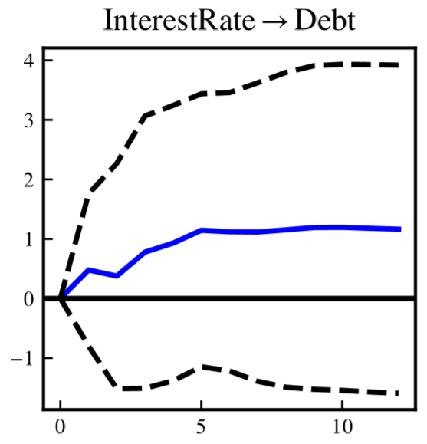
Historical r-g
https://www.imf.org/external/datamapper/datasets
https://www.measuringworth.com
Before COVID: positive
But not clear to predict

Slide 11
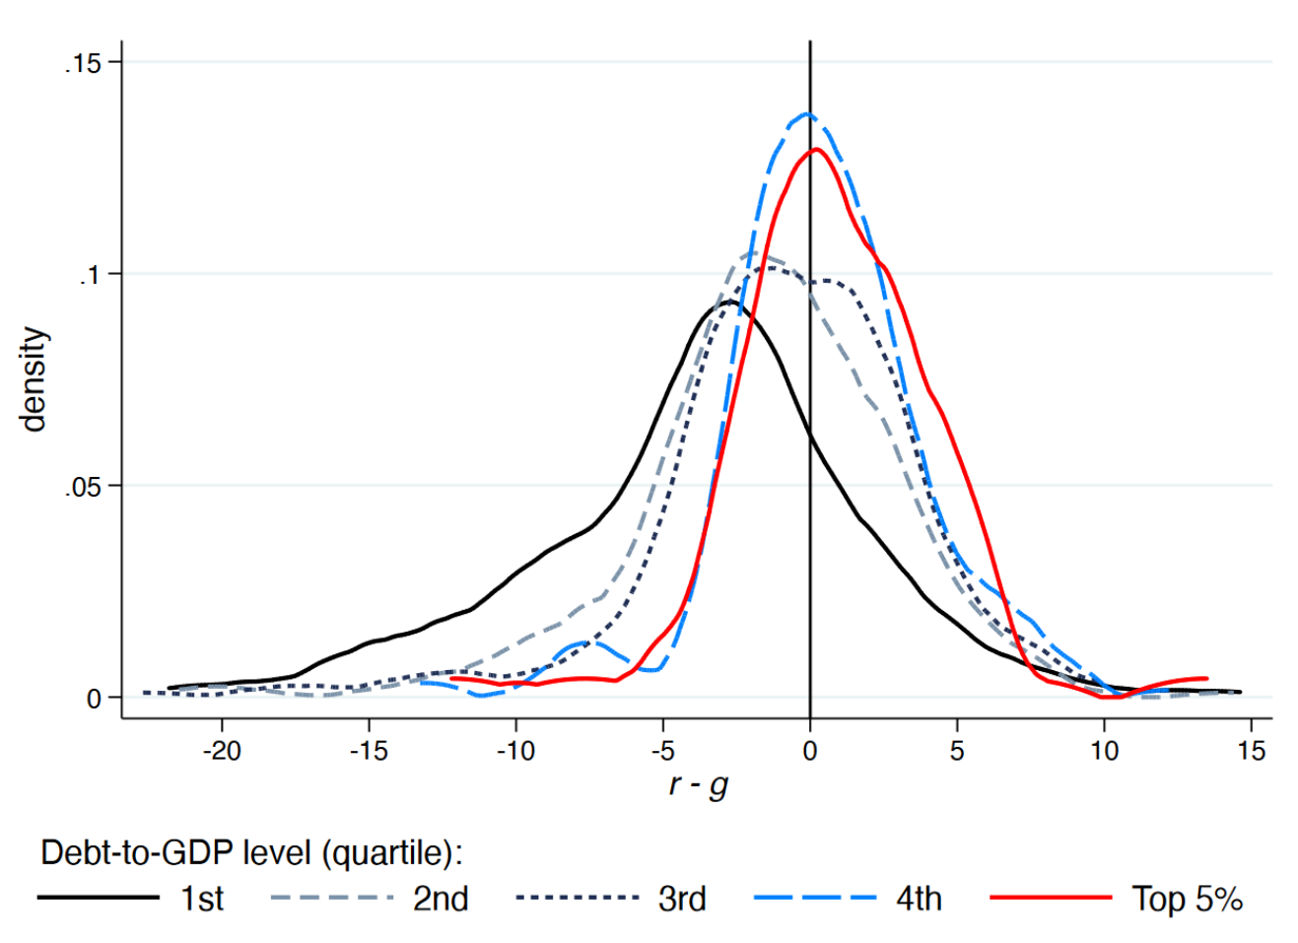
Historical r-g
Weicheng Lian, Andrea F. Presbitero, and Ursula Wiriadinata
Before COVID: positive
But not clear to predict
Lian et al 2020

Slide 12

Conclusions
Concise overview
Literature shows: fiscal support works
But it should be financed. Is this debt sustainable?
r-g is key factor but also hard to predict: future work
History shows: no problem

Slide 13


Thanks! Questions
Luuk Oudshoorn

